Slide 1
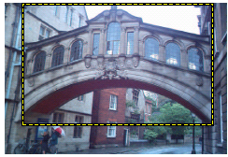
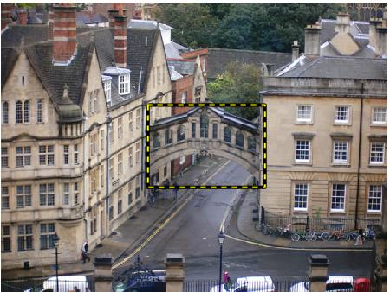
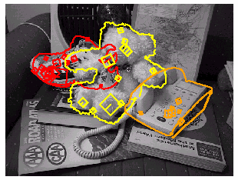
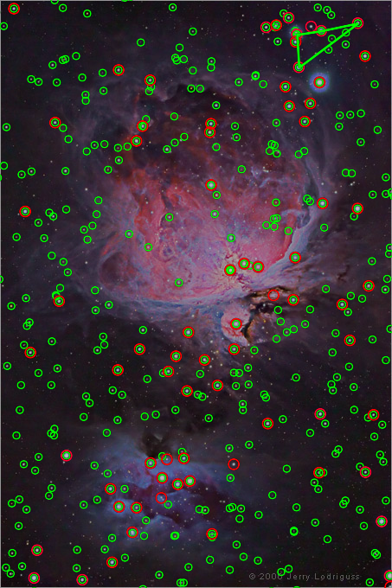
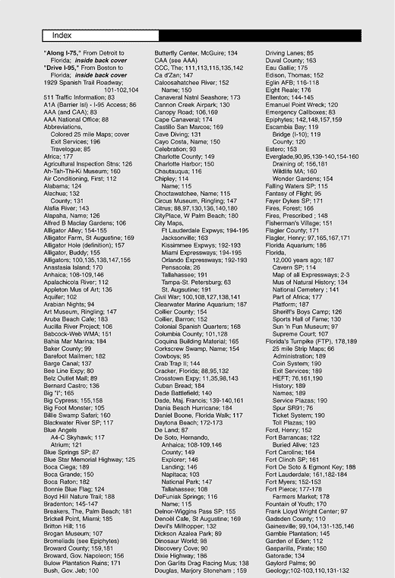


Indexing local features and instance recognition
Devi Parikh
These slides have been borrowed from Kristen Grauman, who borrowed some from others.

Slide 2
Topics overview
Intro
Multiple views and motion
Features & filters
Grouping & fitting
Recognition
Video processing
Slide credit: Kristen Grauman

Slide 3
Topics overview
Intro
Multiple views and motion
Features & filters
Grouping & fitting
Recognition
Indexing local features and instance recognition
Introduction to category recognition
Face detection
Discriminative classifiers for image recognition
Parts-based models
Face recognition
Video processing
Slide credit: Kristen Grauman

Slide 4
Topics overview
Intro
Multiple views and motion
Features & filters
Grouping & fitting
Recognition
Indexing local features and instance recognition
Introduction to category recognition
Face detection
Discriminative classifiers for image recognition
Parts-based models
Face recognition
Video processing
Slide credit: Kristen Grauman

Slide 5
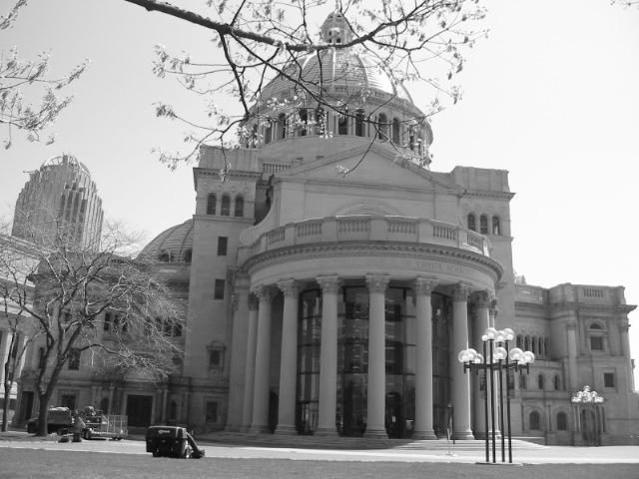
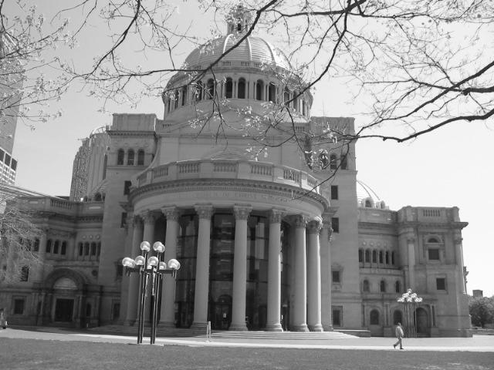
Matching local features
Kristen Grauman

Slide 6
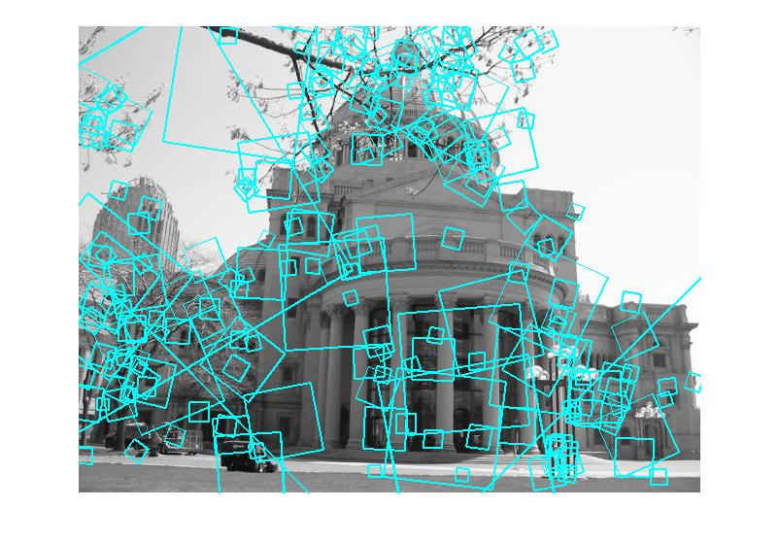
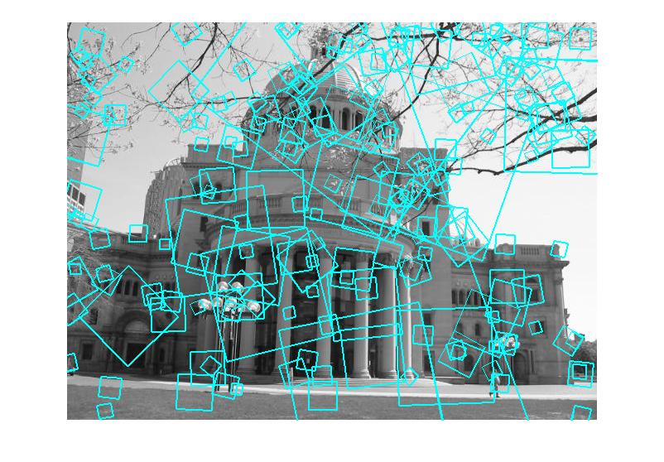
Matching local features
?
Image 1
Image 2
To generate candidate matches, find patches that have the most similar appearance (e.g., lowest SSD)
Simplest approach: compare them all, take the closest (or closest k, or within a thresholded distance)
Kristen Grauman

Slide 7
Matching local features
Image 1
Image 2
In stereo case, may constrain by proximity if we make assumptions on max disparities.
Kristen Grauman

Slide 8
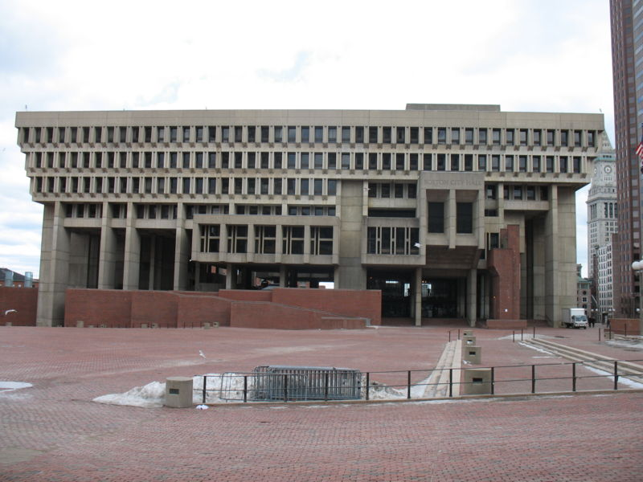
Indexing local features
…
Kristen Grauman

Slide 9
Indexing local features
Each patch / region has a descriptor, which is a point in some high-dimensional feature space (e.g., SIFT)
Descriptor’s feature space
Kristen Grauman
Notes:
9

Slide 10
Indexing local features
When we see close points in feature space, we have similar descriptors, which indicates similar local content.
Query image
Descriptor’s feature space
Database images
Kristen Grauman

Slide 11
Indexing local features
With potentially thousands of features per image, and hundreds to millions of images to search, how to efficiently find those that are relevant to a new image?
Kristen Grauman
Notes:
11

Slide 12
Indexing local features: inverted file index
For text documents, an efficient way to find all pages on which a word occurs is to use an index…
We want to find all images in which a feature occurs.
To use this idea, we’ll need to map our features to “visual words”.
Kristen Grauman

Slide 13
Text retrieval vs. image search
What makes the problems similar, different?
Kristen Grauman

Slide 14
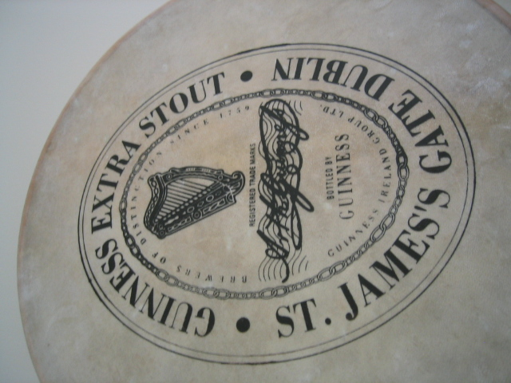
Visual words: main idea
Extract some local features from a number of images …
e.g., SIFT descriptor space: each point is 128-dimensional
Slide credit: D. Nister, CVPR 2006

Slide 15
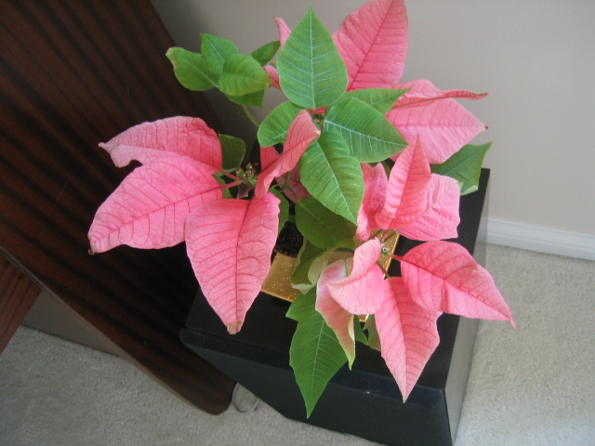
Visual words: main idea

Slide 16
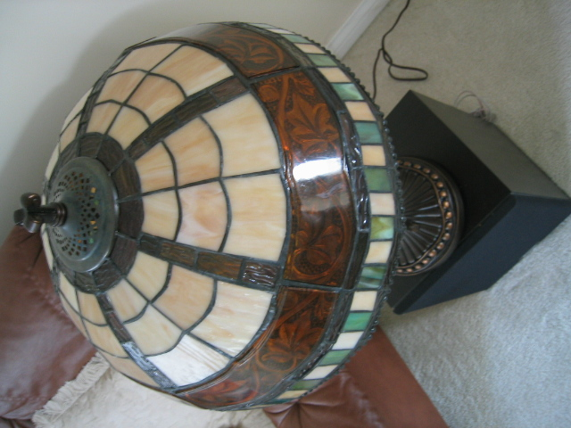
Visual words: main idea

Slide 17

Visual words: main idea

Slide 18
Each point is a local descriptor, e.g. SIFT vector.

Slide 20
Visual words
Map high-dimensional descriptors to tokens/words by quantizing the feature space
Quantize via clustering, let cluster centers be the prototype “words”
Word #2
Determine which word to assign to each new image region by finding the closest cluster center.
Descriptor’s feature space
Kristen Grauman

Slide 21
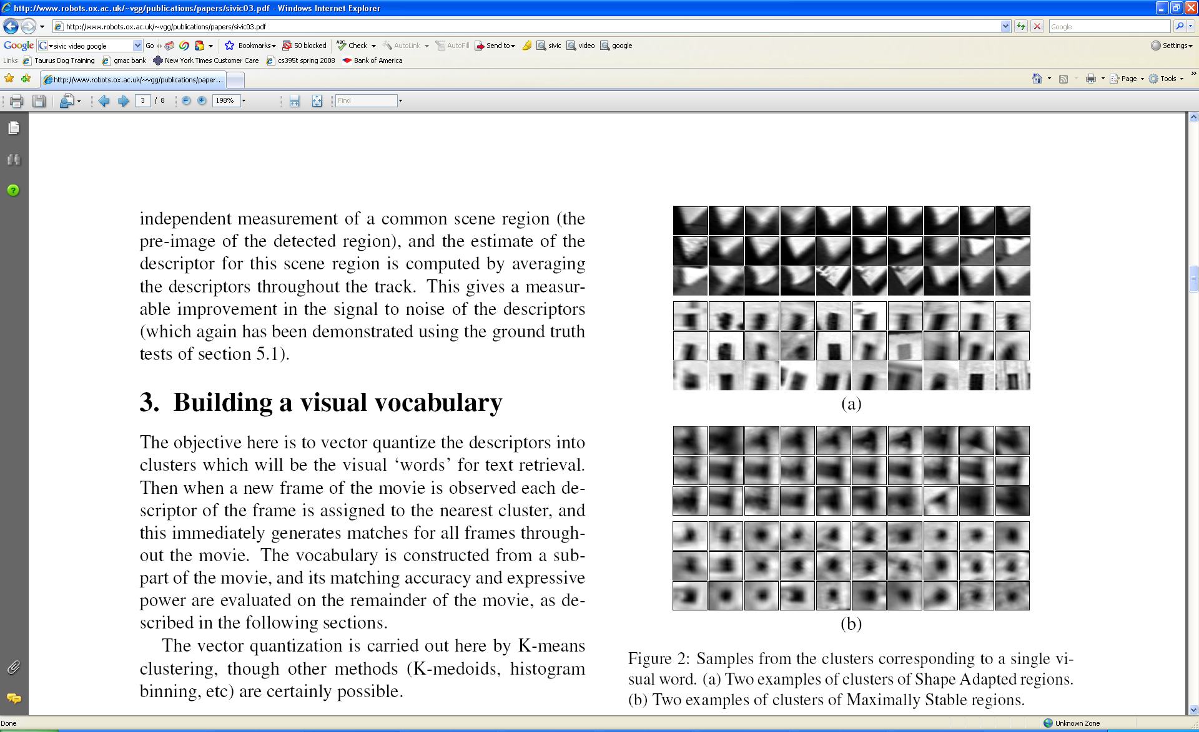
Visual words
Example: each group of patches belongs to the same visual word
Figure from Sivic & Zisserman, ICCV 2003
Kristen Grauman

Slide 22
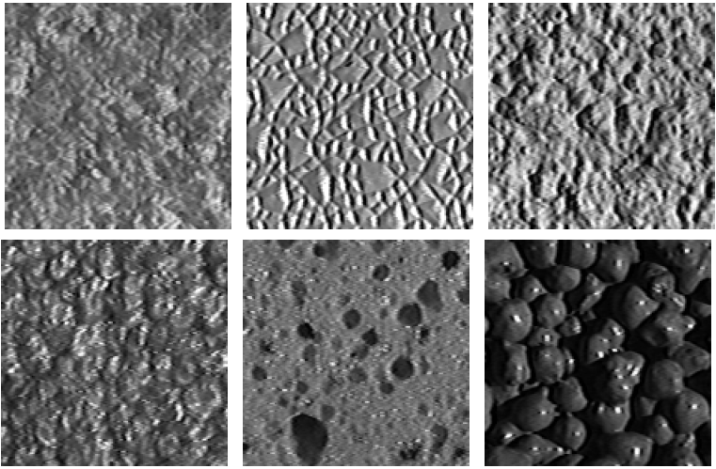
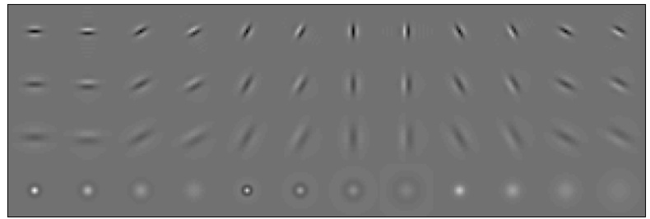
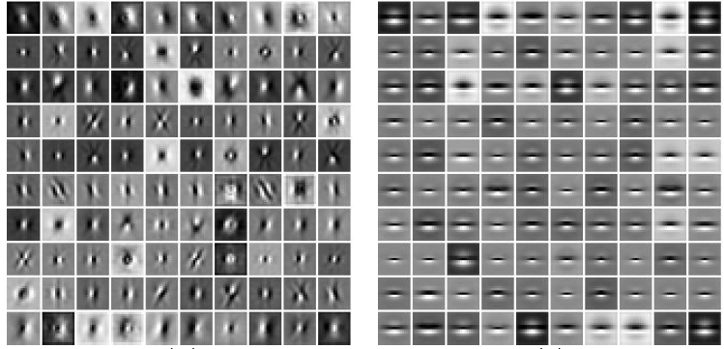
Visual words and textons
First explored for texture and material representations
Texton = cluster center of filter responses over collection of images
Describe textures and materials based on distribution of prototypical texture elements.
Leung & Malik 1999; Varma & Zisserman, 2002
Kristen Grauman

Slide 23
Recall: Texture representation example
Windows with primarily horizontal edges
Both
 | mean d/dx value | mean d/dy value
Win. #1 | 4 | 10
Win.#2 | 18 | 7
Win.#9 | 20 | 20
Dimension 2 (mean d/dy value)
Dimension 1 (mean d/dx value)
…
statistics to summarize patterns in small windows
…
Windows with small gradient in both directions
Windows with primarily vertical edges
Kristen Grauman

Slide 24
Visual vocabulary formation
Issues:
Sampling strategy: where to extract features?
Clustering / quantization algorithm
Unsupervised vs. supervised
What corpus provides features (universal vocabulary?)
Vocabulary size, number of words
Kristen Grauman

Slide 25
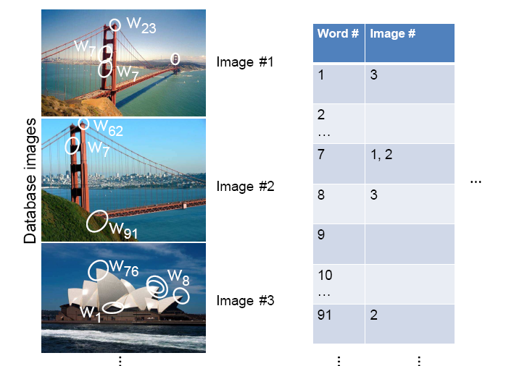
Inverted file index
Database images are loaded into the index mapping words to image numbers
Kristen Grauman

Slide 26
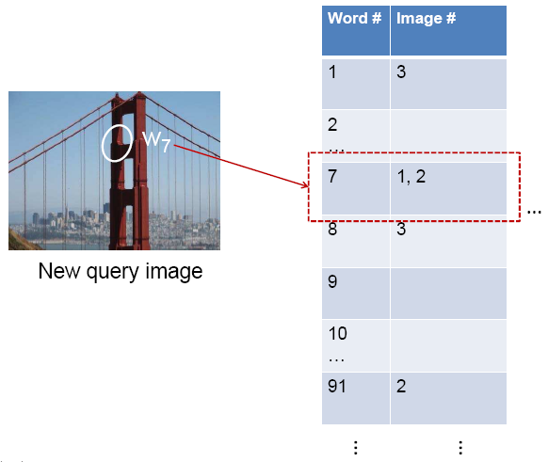
Inverted file index
When will this give us a significant gain in efficiency?
New query image is mapped to indices of database images that share a word.
Kristen Grauman

Slide 27
Inverted file index
New query image is mapped to indices of database images that share a word.
Kristen Grauman

Slide 28
If a local image region is a visual word, how can we summarize an image (the document)?

Slide 29

Analogy to documents
Of all the sensory impressions proceeding to the brain, the visual experiences are the dominant ones. Our perception of the world around us is based essentially on the messages that reach the brain from our eyes. For a long time it was thought that the retinal image was transmitted point by point to visual centers in the brain; the cerebral cortex was a movie screen, so to speak, upon which the image in the eye was projected. Through the discoveries of Hubel and Wiesel we now know that behind the origin of the visual perception in the brain there is a considerably more complicated course of events. By following the visual impulses along their path to the various cell layers of the optical cortex, Hubel and Wiesel have been able to demonstrate that the message about the image falling on the retina undergoes a step-wise analysis in a system of nerve cells stored in columns. In this system each cell has its specific function and is responsible for a specific detail in the pattern of the retinal image.
China is forecasting a trade surplus of $90bn (£51bn) to $100bn this year, a threefold increase on 2004's $32bn. The Commerce Ministry said the surplus would be created by a predicted 30% jump in exports to $750bn, compared with a 18% rise in imports to $660bn. The figures are likely to further annoy the US, which has long argued that China's exports are unfairly helped by a deliberately undervalued yuan. Beijing agrees the surplus is too high, but says the yuan is only one factor. Bank of China governor Zhou Xiaochuan said the country also needed to do more to boost domestic demand so more goods stayed within the country. China increased the value of the yuan against the dollar by 2.1% in July and permitted it to trade within a narrow band, but the US wants the yuan to be allowed to trade freely. However, Beijing has made it clear that it will take its time and tread carefully before allowing the yuan to rise further in value.
sensory, brain,
visual, perception,
retinal, cerebral cortex,
eye, cell, optical
nerve, image
Hubel, Wiesel
China, trade,
surplus, commerce,
exports, imports, US,
yuan, bank, domestic,
foreign, increase,
trade, value
ICCV 2005 short course, L. Fei-Fei

Slide 30
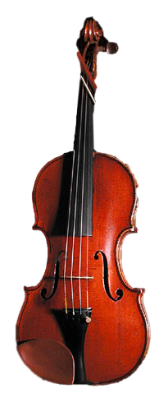
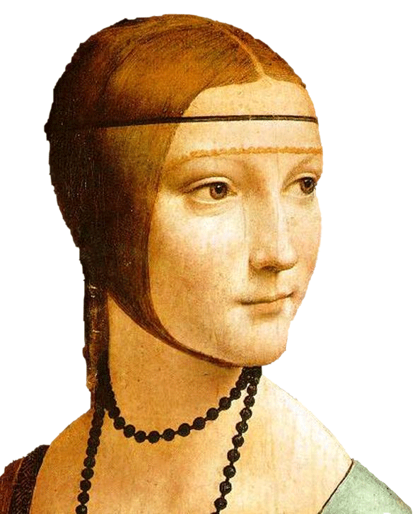
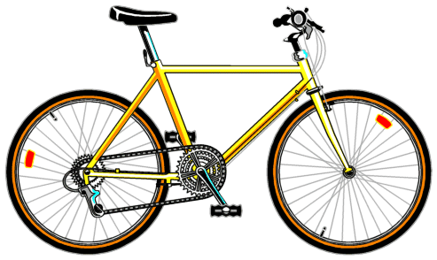
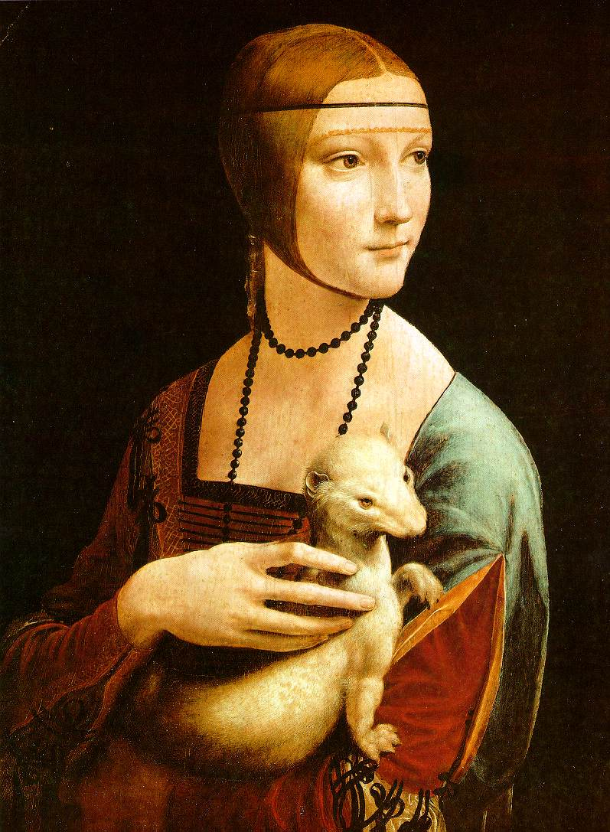

Slide 31

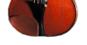

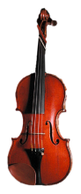

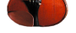

Bags of visual words
Summarize entire image based on its distribution (histogram) of word occurrences.
Analogous to bag of words representation commonly used for documents.
Notes:
31

Slide 32

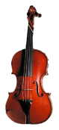



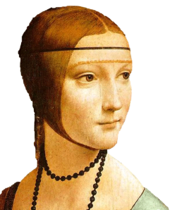
Comparing bags of words
Rank frames by normalized scalar product between their (possibly weighted) occurrence counts---nearest neighbor search for similar images.
[1 8 1 4]
[5 1 1 0]
Kristen Grauman

Slide 33
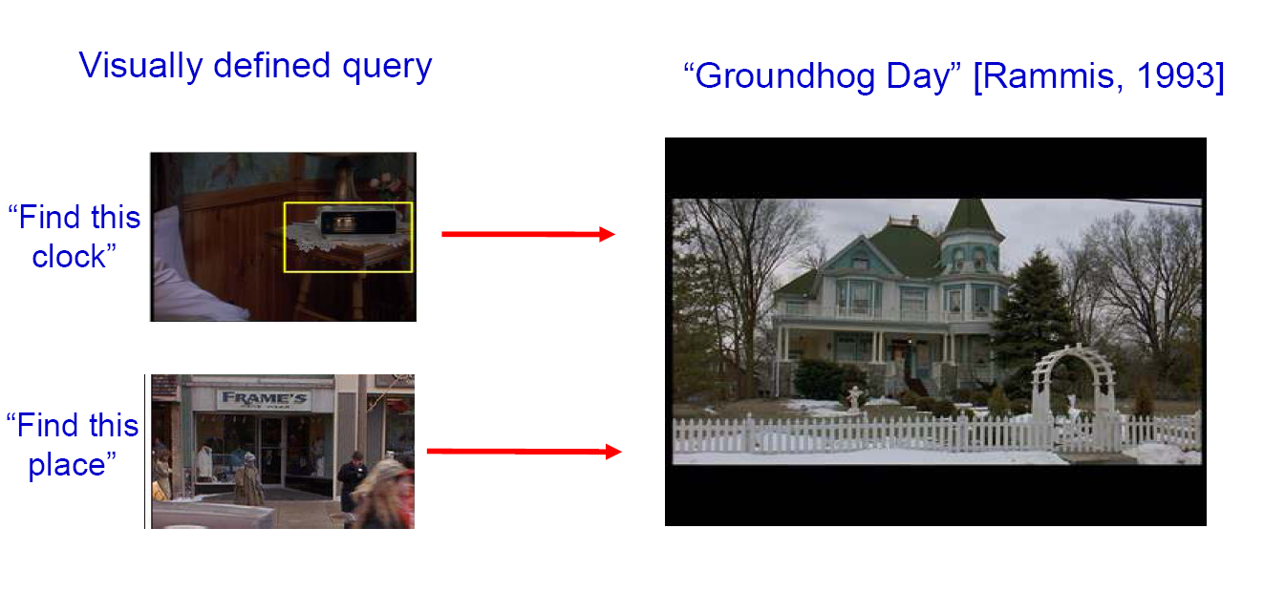
Bags of words for content-based image retrieval
Slide from Andrew Zisserman
Sivic & Zisserman, ICCV 2003

Slide 34
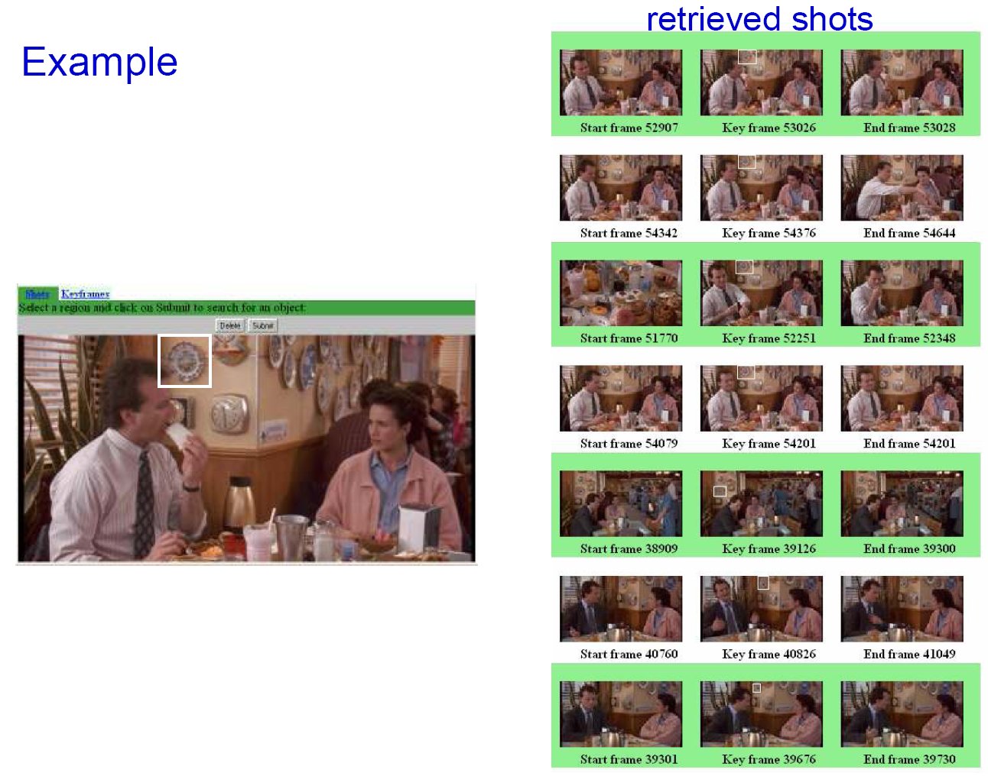
Slide from Andrew Zisserman
Sivic & Zisserman, ICCV 2003

Slide 35

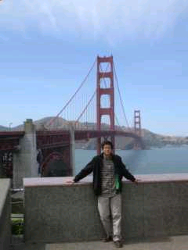
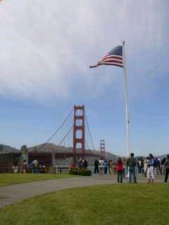
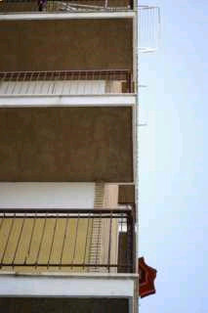
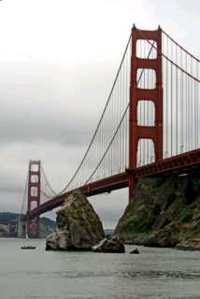
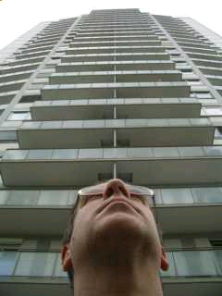
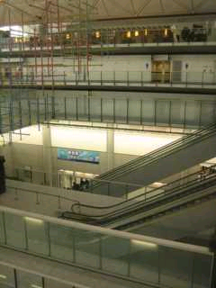
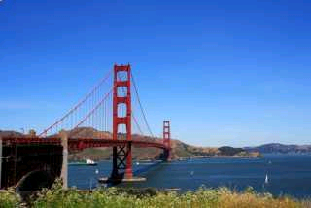

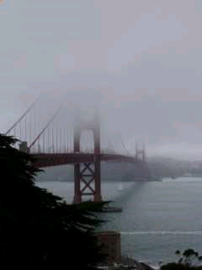
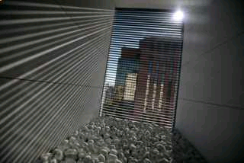
Scoring retrieval quality
Results (ordered):
Database size: 10 images
Relevant (total): 5 images
Query
precision = #relevant / #returned
recall = #relevant / #total relevant
1
0.8
0.6
precision
0.4
0.2
0
0
0.2
0.4
0.6
0.8
1
recall
Slide credit: Ondrej Chum

Slide 36
Vocabulary Trees: hierarchical clustering for large vocabularies
[Nister & Stewenius, CVPR’06]
Slide credit: David Nister
Tree construction:

Slide 37
Vocabulary Tree
[Nister & Stewenius, CVPR’06]
K. Grauman, B. Leibe
Slide credit: David Nister
Training: Filling the tree

Slide 38
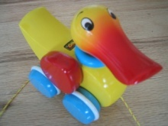

Vocabulary Tree
[Nister & Stewenius, CVPR’06]
K. Grauman, B. Leibe
Slide credit: David Nister
Training: Filling the tree

Slide 39
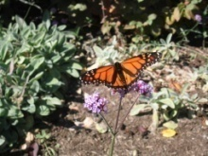

Vocabulary Tree
[Nister & Stewenius, CVPR’06]
K. Grauman, B. Leibe
Slide credit: David Nister
Training: Filling the tree

Slide 40


Vocabulary Tree
[Nister & Stewenius, CVPR’06]
K. Grauman, B. Leibe
Slide credit: David Nister
Training: Filling the tree

Slide 41
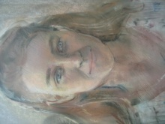

Vocabulary Tree
[Nister & Stewenius, CVPR’06]
K. Grauman, B. Leibe
Slide credit: David Nister
Training: Filling the tree

Slide 42
What is the computational advantage of the hierarchical representation bag of words, vs. a flat vocabulary?

Slide 43
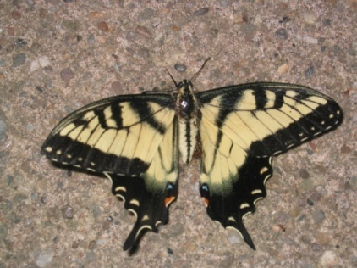
Vocabulary Tree
[Nister & Stewenius, CVPR’06]
Slide credit: David Nister
Recognition

Slide 44
Bags of words: pros and cons
+ flexible to geometry / deformations / viewpoint
+ compact summary of image content
+ provides vector representation for sets
+ very good results in practice
basic model ignores geometry – must verify afterwards, or encode via features
background and foreground mixed when bag covers whole image
optimal vocabulary formation remains unclear
Notes:
44

Slide 45
Summary So Far
Matching local invariant features: useful not only to provide matches for multi-view geometry, but also to find objects and scenes.
Bag of words representation: quantize feature space to make discrete set of visual words
Summarize image by distribution of words
Index individual words
Inverted index: pre-compute index to enable faster search at query time

Slide 46
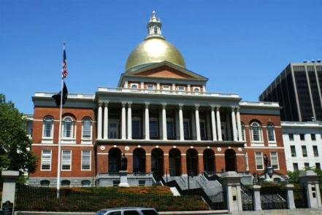
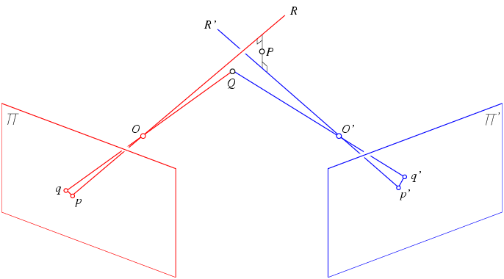



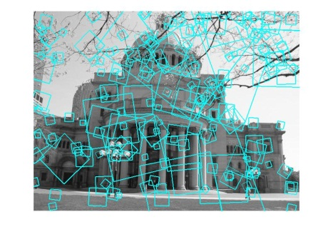
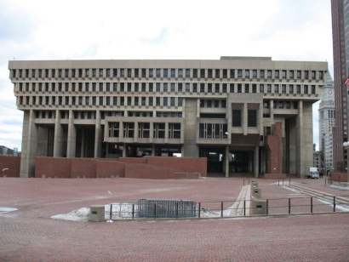
Multi-view matching
?
vs
…
Matching two given views for depth
Search for a matching view for recognition
Kristen Grauman

Slide 47
Instance recognition: remaining issues
How to summarize the content of an entire image? And gauge overall similarity?
How large should the vocabulary be? How to perform quantization efficiently?
Is having the same set of visual words enough to identify the object/scene? How to verify spatial agreement?
How to score the retrieval results?
Kristen Grauman

Slide 48
Instance recognition: remaining issues
How to summarize the content of an entire image? And gauge overall similarity?
How large should the vocabulary be? How to perform quantization efficiently?
Is having the same set of visual words enough to identify the object/scene? How to verify spatial agreement?
How to score the retrieval results?
Kristen Grauman

Slide 49
Instance recognition: remaining issues
How to summarize the content of an entire image? And gauge overall similarity?
How large should the vocabulary be? How to perform quantization efficiently?
Is having the same set of visual words enough to identify the object/scene? How to verify spatial agreement?
How to score the retrieval results?
Kristen Grauman

Slide 50
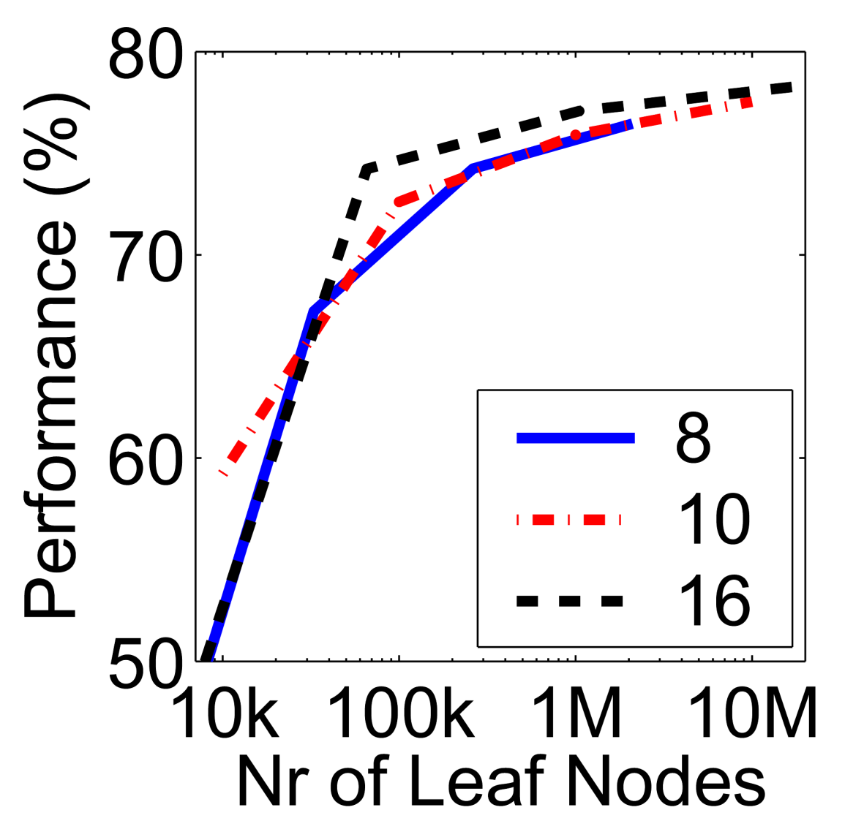
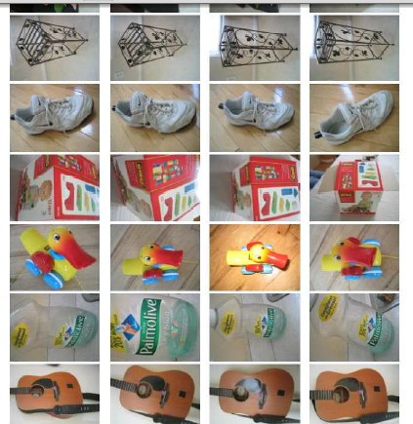
Vocabulary size
Results for recognition task with 6347 images
Branching factors
Influence on performance, sparsity
Nister & Stewenius, CVPR 2006
Kristen Grauman

Slide 51
Instance recognition: remaining issues
How to summarize the content of an entire image? And gauge overall similarity?
How large should the vocabulary be? How to perform quantization efficiently?
Is having the same set of visual words enough to identify the object/scene? How to verify spatial agreement?
How to score the retrieval results?
Kristen Grauman

Slide 52
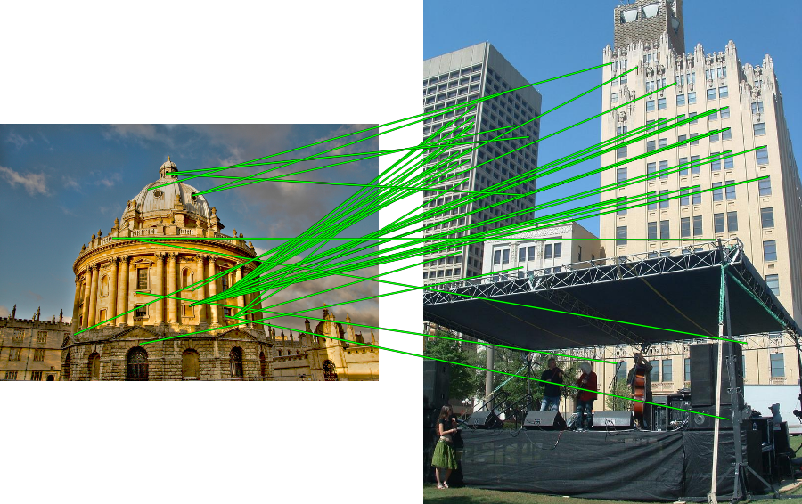

Spatial Verification
Query
Query
DB image with high BoW similarity
DB image with high BoW similarity
Both image pairs have many visual words in common.
Slide credit: Ondrej Chum

Slide 53


Spatial Verification
Query
Query
DB image with high BoW similarity
DB image with high BoW similarity
Only some of the matches are mutually consistent
Slide credit: Ondrej Chum

Slide 54
Spatial Verification: two basic strategies
RANSAC
Typically sort by BoW similarity as initial filter
Verify by checking support (inliers) for possible transformations
e.g., “success” if find a transformation with > N inlier correspondences
Generalized Hough Transform
Let each matched feature cast a vote on location, scale, orientation of the model object
Verify parameters with enough votes
Kristen Grauman

Slide 55
RANSAC verification

Slide 56
Recall: Fitting an affine transformation
Approximates viewpoint changes for roughly planar objects and roughly orthographic cameras.

Slide 57
RANSAC verification

Slide 58










Video Google System
Query region
Collect all words within query region
Inverted file index to find relevant frames
Compare word counts
Spatial verification
Sivic & Zisserman, ICCV 2003
Demo online at : http://www.robots.ox.ac.uk/~vgg/research/vgoogle/index.html
Retrieved frames
Kristen Grauman
Notes:
58

Slide 59


Example Applications
Aachen Cathedral
Mobile tourist guide
Self-localization
Object/building recognition
Photo/video augmentation
[Quack, Leibe, Van Gool, CIVR’08]

Slide 60

Application: Large-Scale Retrieval
Query
Results from 5k Flickr images (demo available for 100k set)
[Philbin CVPR’07]

Slide 61

Web Demo: Movie Poster Recognition
50’000 movie posters indexed
Query-by-image from mobile phone available in Switzer- land

Slide 62


Notes:
http://www.google.com/mobile/goggles

Slide 63
Spatial Verification: two basic strategies
RANSAC
Typically sort by BoW similarity as initial filter
Verify by checking support (inliers) for possible transformations
e.g., “success” if find a transformation with > N inlier correspondences
Generalized Hough Transform
Let each matched feature cast a vote on location, scale, orientation of the model object
Verify parameters with enough votes
Kristen Grauman

Slide 64

Voting: Generalized Hough Transform
If we use scale, rotation, and translation invariant local features, then each feature match gives an alignment hypothesis (for scale, translation, and orientation of model in image).
Model
Novel image
Adapted from Lana Lazebnik

Slide 65
Voting: Generalized Hough Transform
A hypothesis generated by a single match may be unreliable,
So let each match vote for a hypothesis in Hough space
Model
Novel image

Slide 66
Gen Hough Transform details (Lowe’s system)
Training phase: For each model feature, record 2D location, scale, and orientation of model (relative to normalized feature frame)
Test phase: Let each match btwn a test SIFT feature and a model feature vote in a 4D Hough space
Use broad bin sizes of 30 degrees for orientation, a factor of 2 for scale, and 0.25 times image size for location
Vote for two closest bins in each dimension
Find all bins with at least three votes and perform geometric verification
Estimate least squares affine transformation
Search for additional features that agree with the alignment
David G. Lowe. "Distinctive image features from scale-invariant keypoints.” IJCV 60 (2), pp. 91-110, 2004.
Slide credit: Lana Lazebnik

Slide 67



Example result
Background subtract for model boundaries
Objects recognized,
Recognition in spite of occlusion
[Lowe]

Slide 68
Recall: difficulties of voting
Noise/clutter can lead to as many votes as true target
Bin size for the accumulator array must be chosen carefully
In practice, good idea to make broad bins and spread votes to nearby bins, since verification stage can prune bad vote peaks.

Slide 69
Gen Hough vs RANSAC
GHT
Single correspondence -> vote for all consistent parameters
Represents uncertainty in the model parameter space
Linear complexity in number of correspondences and number of voting cells; beyond 4D vote space impractical
Can handle high outlier ratio
RANSAC
Minimal subset of correspondences to estimate model -> count inliers
Represents uncertainty in image space
Must search all data points to check for inliers each iteration
Scales better to high-d parameter spaces
Kristen Grauman

Slide 70
Instance recognition
Motivation – visual search
Visual words
quantization, index, bags of words
Spatial verification
affine; RANSAC, Hough
Other text retrieval tools
tf-idf, query expansion
Example applications

Slide 71
What else can we borrow from text retrieval?
China is forecasting a trade surplus of $90bn (£51bn) to $100bn this year, a threefold increase on 2004's $32bn. The Commerce Ministry said the surplus would be created by a predicted 30% jump in exports to $750bn, compared with a 18% rise in imports to $660bn. The figures are likely to further annoy the US, which has long argued that China's exports are unfairly helped by a deliberately undervalued yuan. Beijing agrees the surplus is too high, but says the yuan is only one factor. Bank of China governor Zhou Xiaochuan said the country also needed to do more to boost domestic demand so more goods stayed within the country. China increased the value of the yuan against the dollar by 2.1% in July and permitted it to trade within a narrow band, but the US wants the yuan to be allowed to trade freely. However, Beijing has made it clear that it will take its time and tread carefully before allowing the yuan to rise further in value.
China, trade,
surplus, commerce,
exports, imports, US,
yuan, bank, domestic,
foreign, increase,
trade, value

Slide 72

tf-idf weighting
Term frequency – inverse document frequency
Describe frame by frequency of each word within it, downweight words that appear often in the database
(Standard weighting for text retrieval)
Number of occurrences of word i in document d
Total number of documents in database
Number of documents word i occurs in, in whole database
Number of words in document d
Kristen Grauman

Slide 73
Query expansion
Query: golf green
Results:
- How can the grass on the greens at a golf course be so perfect?
For example, a skilled golfer expects to reach the green on a par-four hole in ... - Manufactures and sells synthetic golf putting greens and mats.
Irrelevant result can cause a `topic drift’:
Volkswagen Golf, 1999, Green, 2000cc, petrol, manual, , hatchback, 94000miles, 2.0 GTi, 2 Registered Keepers, HPI Checked, Air-Conditioning, Front and Rear Parking Sensors, ABS, Alarm, Alloy
Slide credit: Ondrej Chum

Slide 74













Query Expansion
Results
…
Spatial verification
Query image
New results
New query
Chum, Philbin, Sivic, Isard, Zisserman: Total Recall…, ICCV 2007
Slide credit: Ondrej Chum

Slide 75
Recognition via alignment
Pros:
Effective when we are able to find reliable features within clutter
Great results for matching specific instances
Cons:
Scaling with number of models
Spatial verification as post-processing – not seamless, expensive for large-scale problems
Not suited for category recognition.
Kristen Grauman

Slide 76
Summary
Matching local invariant features
Useful not only to provide matches for multi-view geometry, but also to find objects and scenes.
Bag of words representation: quantize feature space to make discrete set of visual words
Summarize image by distribution of words
Index individual words
Inverted index: pre-compute index to enable faster search at query time
Recognition of instances via alignment: matching local features followed by spatial verification
Robust fitting : RANSAC, GHT
Kristen Grauman

Slide 77


Making the Sky Searchable: Fast Geometric Hashing for Automated Astrometry
Sam Roweis, Dustin Lang & Keir Mierle
University of Toronto
David Hogg & Michael Blanton
New York University
77

Slide 78


Example
A shot of the Great Nebula, by Jerry Lodriguss (c.2006), from astropix.com
http://astrometry.net/gallery.html

Slide 79


Example
An amateur shot of M100, by Filippo Ciferri (c.2007) from flickr.com http://astrometry.net/gallery.html

Slide 80


Example
A beautiful image of Bode's nebula (c.2007) by Peter Bresseler, from starlightfriend.de http://astrometry.net/gallery.html

Slide 81
Questions?
Slide credit: Devi Parikh

